Slide 1
Previous Class Recap
Def: A finite automaton 𝑀 is a 5-tuple (𝑄𝑄, Z, 𝛿𝛿, 𝑞₀, 𝐹)
A list of 5 components
𝑀 = (𝑄𝑄, Z, 𝛿𝛿, 𝑞₀, 𝐹)
𝑄𝑄: finite set of states
Z: alphabet, finite set symbols
𝛿𝛿: transition function
𝛿𝛿: 𝑄𝑄 × Z → 𝑄𝑄
𝑞₀: start state
𝐹: set of ACCEPT states
𝛿𝛿 𝑞, 𝑎 = 𝑟
𝐹 ⊆ 𝑄𝑄
a
Can have more than 1 accept state
𝑞 𝑟

Slide 2
Previous Class Recap
Def: A language is regular if some finite automaton recognizes it.
𝐿 𝑀₁ = 𝑤 𝑤 contains substring 11 = 𝐴
0
0,1
𝑀₁
1
1
𝐴 is a regular language
𝑞₁
𝑞₂
𝑞₃
𝑀₁ = (𝑄𝑄, Z, 𝛿𝛿, 𝑞₀, 𝐹) 𝑄𝑄 = | {𝑞₁, 𝑞₂, 𝑞₃} |  |  | 𝑞₀ = | 0 𝑞₁
Z = | {0,1} |  |  | 𝐹 = | {𝑞₃}
𝛿𝛿 = |  | 0 | 1
 | 𝒒𝒒₁ | 𝑞₁ | 𝑞₂
 | 𝒒𝒒_{𝟐𝟐} | 𝑞₁ | 𝑞₃
 | 𝒒𝒒_{𝟑𝟑} | 𝑞₃ | 𝑞₃

Slide 3
Goal for this class
Develop a toolbox of techniques for designing automata to recognize
particular languages.
Operations that applies to languages
Look at three regular operations on languages
Union ∪
Concatenation ∘
Star ∗
Build regular expressions
Using Atomic Components and Regular operations
Proof closure properties for regular languages
Applying a regular operation to the languages leaves you in the same class of objects
Show finite automata equivalent to regular expressions
Building blocks today

Slide 4
Regular Operations on Languages
Let 𝐴, 𝐵 be languages:
Example:
Let 𝐴 = {𝑎𝑎, 𝑏} and 𝐵 = {𝑥, 𝑦𝑦}
Union
𝐴 ∪ 𝐵 = {𝑤|𝑤 ∈ 𝐴 or 𝑤 ∈ 𝐵}
Concatenation
𝐴 ∘ 𝐵 = 𝑥𝑦 𝑥 ∈ 𝐴 and 𝑦 ∈ 𝐵} = 𝐴𝐵
Star
𝐴 ∪ 𝐵 = {𝑎𝑎, 𝑏, 𝑥, 𝑦𝑦}
𝐴 ∘ 𝐵 = {𝑎𝑎𝑥, 𝑎𝑎𝑦𝑦, 𝑏𝑥, 𝑏𝑦𝑦}
_{𝐴}∗
= 𝑥₁ … 𝑥_{𝑘} each 𝑥_{𝑖} ∈ 𝐴 for 𝑘 ≥ 0}
𝐴∗ ={ε, 𝑎𝑎, 𝑏, 𝑎𝑎𝑎𝑎, 𝑎𝑎𝑏, 𝑏𝑎𝑎, 𝑏𝑏,
𝑎𝑎𝑎𝑎𝑎𝑎, 𝑎𝑎𝑎𝑎𝑏, 𝑎𝑎𝑏𝑎𝑎, 𝑎𝑎𝑏𝑏, … }
Note: ε ∈ 𝐴∗ always
You can always have zero elements together, so you get the empty string

Slide 5
Regular Expressions (RegEx)
5 + 3 = 8
Like we use arithmetical operations to create arithmetical expressions, we can use regular operations to create regular expressions.
Atomic Elements
Built from Z, members Z, ∅, ε
Composite Elements
Example:
0 ∪ 1 ∗ = Z∗ all the strings over Z
Z∗1 = all the strings that end with 1
By using ∪, ∘, ∗
What is the result of a regular expression?
Z∗ ∘ 1
Z∗11Z∗ = all the strings that contain 11
The result is a Language

Slide 6

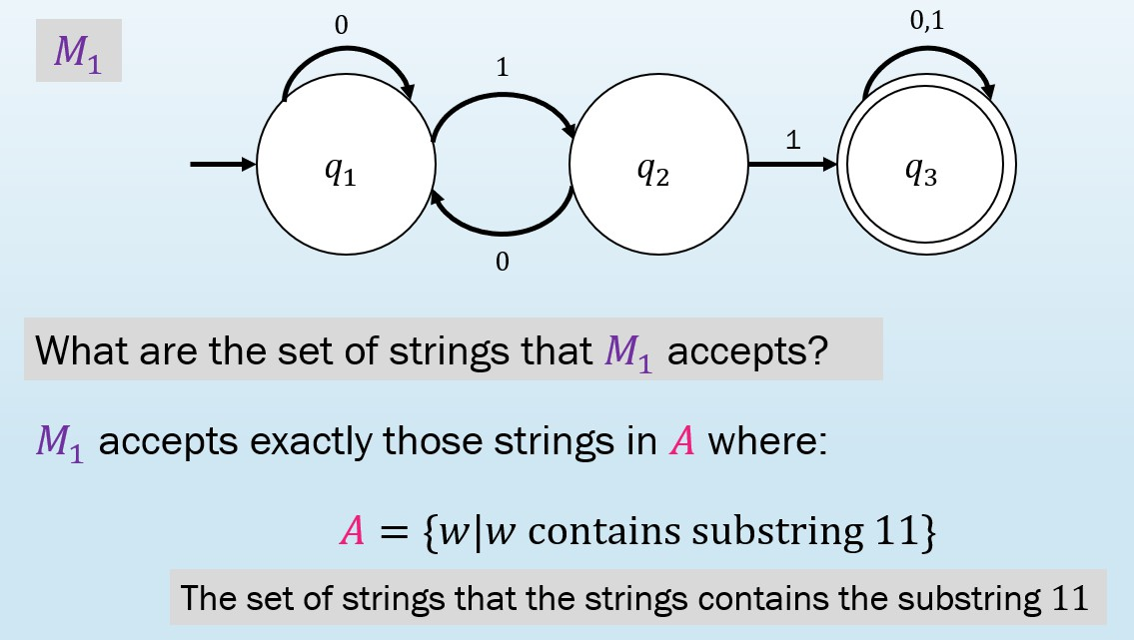
Regular Expressions (RegEx)
Atomic Elements
Built from Z, members Z, ∅, ε
Composite Elements By using ∪, ∘, ∗
Example:
0 ∪ 1 ∗ = all the strings over Z
_{Z}∗
Z∗1 = all the strings that end with 1
Z∗11Z∗ = all the strings that contain 11
What is the result of a regular expression?
=
Both models recognize the same language
The result is a Language
DFAs are equivalent to regular expressions

Slide 7
Closure Properties for RegEx - Union
Theorem: If 𝐴₁, 𝐴₂ are regular languages, so is 𝐴₁ ∪ 𝐴₂ (closure under ∪)
Applying the ∪ to the languages 𝐴₁, 𝐴₂ leaves you in the same class of objects.
The result is another regular language.
Example: The ℕ is closed in addition, when you add 2 positive integers the result is a positive integer.
But not closed in division, since you can get a rational number.

Slide 8
Closure Properties for RegEx - Union
Theorem: If 𝐴₁, 𝐴₂ are regular languages, so is 𝐴₁ ∪ 𝐴₂ (closure under ∪)
Proof Idea:
What do we know about 𝐴₁ and 𝐴₂ if they are regular?
𝐴₁ and 𝐴₂ are regular, we know that some finite automaton 𝑀₁ recognizes 𝐴₁ and some finite automaton 𝑀₂ recognizes 𝐴₂.
To prove that 𝐴₁ ∪ 𝐴₂ is regular, we need to demonstrate that a finite automaton 𝑀
recognizes 𝐴₁ ∪ 𝐴₂
We construct 𝑀 from 𝑀₁ and 𝑀₂.
DFA 𝑀 must accept its input exactly when either 𝑀₁ or 𝑀₂ would accept it in order to recognize the union language.
It works by simulating both 𝑀₁ and 𝑀₂ and accepting if either of the simulations accept.
How can we make machine 𝑀 simulate 𝑀₁ and 𝑀₂?

Slide 9

Closure Properties for RegEx - Union
Theorem: If 𝐴₁, 𝐴₂ are regular languages, so is 𝐴₁ ∪ 𝐴₂ (closure under ∪)
How can we make machine 𝑀 simulate 𝑀₁ and 𝑀₂?
Tentative Approach: Combine the machines
First simulate 𝑀₁ on the input and then simulate 𝑀₂ on the input.
If either 𝑀₁ or 𝑀₂ accept the input, 𝑀 accepts the input
𝑀₁
𝑎
𝑀₂ 𝑀
𝑎
𝑎
𝑏
𝑎
𝑏
𝑏
𝑏

Slide 10
Closure Properties for RegEx - Union
Theorem: If 𝐴₁, 𝐴₂ are regular languages, so is 𝐴₁ ∪ 𝐴₂ (closure under ∪)
How can we make machine 𝑀 simulate 𝑀₁ and 𝑀₂?
 | Tentative Approach: Combine the machines
First simulate 𝑀₁ on the input and then simulate 𝑀₂ on the input. If either 𝑀₁ or 𝑀₂ accept the input, 𝑀 accepts the input ^{𝑀 𝑎} But we must be careful here! Not valid DFA! 𝑏 _{𝑎} Once the symbols of the input have been read and used to simulate 𝑀₁, we can’t “rewind the 𝑏 input” to try the simulation on 𝑀₂.

Slide 11
Closure Properties for RegEx - Union
Theorem: If 𝐴₁, 𝐴₂ are regular languages, so is 𝐴₁ ∪ 𝐴₂ (closure under ∪)
How can we make machine 𝑀 simulate 𝑀₁ and 𝑀₂?
Correct Approach: Simulate both 𝑀₁ and 𝑀₂ simultaneously.
Each state in 𝑀 corresponds to two states, one from 𝑀₁ and the other from 𝑀₂
𝑀₁
𝑀₂
𝑀
𝑎
𝑡₁
𝑎
𝑔₁
𝑎
𝑡₁ 𝑔₁
𝑡₀
𝑔₀
𝑡₀ 𝑔₀
𝑏
𝑡₂
𝑏
𝑔₂
𝑡₂ 𝑔₂
𝑏

Slide 12
Closure Properties for RegEx - Union
Theorem: If 𝐴₁, 𝐴₂ are regular languages, so is 𝐴₁ ∪ 𝐴₂ (closure under ∪)
Proof: by Construction
Let 𝑀₁ = (𝑄𝑄₁, Z, 𝛿𝛿₁ , 𝑞₁ , 𝐹₁ ) recognize 𝐴₁
𝑀₂ = (𝑄𝑄₂, Z, 𝛿𝛿₂ , 𝑞₂ , 𝐹₂ ) recognize 𝐴₂
Construct 𝑀 = (𝑄𝑄 , Z, 𝛿𝛿 , 𝑞₀, 𝐹) recognizing 𝐴₁ ∪ 𝐴₂
𝑀 should accept input 𝑤 if either 𝑀₁ or 𝑀₂ accept 𝑤.
The possibilities we have to keep track in 𝑀 are all the pair of states of 𝑀₁ and 𝑀₂
𝑡₀ 𝑔
𝑀₁
𝑀₂
𝑀
𝑎
𝑡₁
𝑎
𝑔₁
𝑎
𝑡₁ 𝑔₁
𝑡₀
𝑔₀
𝑡₀ 𝑔₀
𝑡 𝑔
0
𝑏
𝑡₂
𝑏
𝑔₂
𝑡₂ 𝑔₂
𝑏

Slide 13
Closure Properties for RegEx - Union
Theorem: If 𝐴₁, 𝐴₂ are regular languages, so is 𝐴₁ ∪ 𝐴₂
Proof: by Construction Components of 𝑀:
(closure under ∪)
𝑄𝑄 =
𝑄𝑄₁ × 𝑄𝑄₂
= 𝑞₁, 𝑞₂ 𝑞₁ ∈ 𝑄𝑄₁ and 𝑞₂ ∈ 𝑄𝑄₂}
The set of all pairs of states, the first from 𝑄𝑄₁
and the second from 𝑄𝑄₂.
𝑞₀ = (𝑞₁, 𝑞₂)
𝛿𝛿 𝑞, 𝑟 , 𝑎 =
𝐹 = 𝐹₁ × 𝑄𝑄₂
The pair of initial states from 𝑀₁ and 𝑀₂
𝛿𝛿₁ 𝑞, 𝑎 , 𝛿𝛿₂ 𝑟, 𝑎
Gets a state of 𝑀 (which is a pair of states from 𝑀₁ and 𝑀₂), together with an input symbol, and returns 𝑀’s next state.
∪ 𝑄𝑄₁ × 𝐹₂
Set of pairs in which either member is an accept state of 𝑀₁ or 𝑀₂
Accept state of the 𝑀₁ set of accept states and any state of 𝑀₂.
OR any state of 𝑀₁and the accept states of 𝑀₂
Why not 𝐹 = 𝐹₁ × 𝐹₂?
This gives the intersection.

Slide 14




Closure Properties for RegEx - Union
Theorem: If 𝐴₁, 𝐴₂ are regular languages, so is 𝐴₁ ∪ 𝐴₂ (closure under ∪)
Proof: by Construction Components of 𝑀:
𝑄𝑄 = 𝑄𝑄1 × 𝑄𝑄2 = 𝑞1, 𝑞2 𝑞1 ∈ 𝑄𝑄1 and 𝑞2 ∈ 𝑄𝑄2} The set of all pairs of states, the first from 𝑄𝑄₁
and the second from 𝑄𝑄₂.
𝑞₀ = (𝑞₁, 𝑞₂) The pair of initial states from 𝑀₁ and 𝑀₂
𝛿𝛿 𝑞, 𝑟 , 𝑎 = 𝛿𝛿1 𝑞, 𝑎 , 𝛿𝛿2 𝑟, 𝑎 Gets a state of 𝑀 (which is a pair of states from 𝑀₁ and 𝑀₂),
together with an input symbol, and returns M’s next state.
𝐹 = 𝐹₁ × 𝑄𝑄₂ ∪ 𝑄𝑄₁ × 𝐹₂ Set of pairs in which either member is an accept state of 𝑀₁ or 𝑀₂
Accept state for the first element OR any state for the first Why not 𝐹 = 𝐹₁ × 𝐹₂?
and any state for the second element and accept state for
^{element. the second element.} This gives the intersection.
Question:
In the proof, if 𝑀₁ and 𝑀₂ are finite automata where 𝑀₁ has 𝑘₁ states and 𝑀₂ has 𝑘₂ states. Then how many states does 𝑀 have?
𝑘₁ + 𝑘₂
𝑘₁
(c)
2 ₊
𝑘₂
2
𝑘₁ × 𝑘₂
You need all the possible pairs of states from 𝑀₁ and 𝑀₂. So, it is the # of states in 𝑀₁ × # of states in 𝑀₂= 𝑘₁ × 𝑘₂

Slide 15
Closure Properties for RegEx - Union
Components of 𝑀:
𝑄𝑄 = 𝑄𝑄₁ × 𝑄𝑄₂
𝑞₀ = (𝑡₀, 𝑟₀)
Example:
𝑀₁
𝑀₂
𝑎
𝑏
𝑎
𝑎, 𝑏
𝑡
0
𝑡
1
𝑟₀
𝑟₁
𝛿𝛿 𝑡, 𝑟 , 𝑎 = 𝛿𝛿₁ 𝑡, 𝑎 , 𝛿𝛿₂
𝐹 = 𝐹₁ × 𝑄𝑄₂ ∪ 𝑄𝑄₁ × 𝐹₂
𝑟, 𝑎
𝑎, 𝑏
𝑏
Is the string 𝑤 = 𝑎𝑏𝑎 in the union?
Yes! In this case, both DFAs accept the string.

Slide 16
Closure Properties for RegEx - Union
Components of 𝑀:
𝑄𝑄 = 𝑄𝑄₁ × 𝑄𝑄₂
𝑞₀ = (𝑡₀, 𝑟₀)
Example:
𝑀₁
𝑀₂
𝑎
𝑏
𝑎
𝑎, 𝑏
𝑡
0
𝑡
1
𝑟₀
𝑟₁
𝛿𝛿 𝑡, 𝑟 , 𝑎 = 𝛿𝛿₁ 𝑡, 𝑎 , 𝛿𝛿₂
𝐹 = 𝐹₁ × 𝑄𝑄₂ ∪ 𝑄𝑄₁ × 𝐹₂
𝑟, 𝑎
𝑎, 𝑏
𝑏
𝑀
𝑡₀ , 𝑟₀
𝑡₁ , 𝑟₀
𝑡₀ , 𝑟₁
𝑡₁ , 𝑟₁

Slide 17
Closure Properties for RegEx - Union
Components of 𝑀:
𝑄𝑄 = 𝑄𝑄₁ × 𝑄𝑄₂
𝑞₀ = (𝑡₀, 𝑟₀)
Example:
𝑀₁
𝑀₂
𝑎
𝑏
𝑎
𝑎, 𝑏
𝑡
0
𝑡
1
𝑟₀
𝑟₁
𝛿𝛿 𝑡, 𝑟 , 𝑎 = 𝛿𝛿₁ 𝑡, 𝑎 , 𝛿𝛿₂
𝐹 = 𝐹₁ × 𝑄𝑄₂ ∪ 𝑄𝑄₁ × 𝐹₂
𝑟, 𝑎
𝑎, 𝑏
𝑏
𝑀
𝑡₀ , 𝑟₀
𝑡₁ , 𝑟₀
𝑡₀ , 𝑟₁
𝑡₁ , 𝑟₁

Slide 18
Closure Properties for RegEx - Union
Components of 𝑀:
𝑄𝑄 = 𝑄𝑄₁ × 𝑄𝑄₂
𝑞₀ = (𝑡₀, 𝑟₀)
Example:
𝑀₁
𝑀₂
𝑎
𝑏
𝑎
𝑎, 𝑏
𝑡
0
𝑡
1
𝑟₀
𝑟₁
𝛿𝛿 𝑡, 𝑟 , 𝑎 = 𝛿𝛿₁ 𝑡, 𝑎 , 𝛿𝛿₂
𝐹 = 𝐹₁ × 𝑄𝑄₂ ∪ 𝑄𝑄₁ × 𝐹₂
𝑟, 𝑎
𝑎, 𝑏
𝑏
𝑀
𝑡₀ , 𝑟₀
𝑡₁ , 𝑟₀
𝑎
𝑡₀ , 𝑟₁
𝑡₁ , 𝑟₁

Slide 19
Closure Properties for RegEx - Union
Components of 𝑀:
𝑄𝑄 = 𝑄𝑄₁ × 𝑄𝑄₂
𝑞₀ = (𝑡₀, 𝑟₀)
Example:
𝑀₁
𝑀₂
𝑎
𝑏
𝑎
𝑎, 𝑏
𝑡
0
𝑡
1
𝑟₀
𝑟₁
𝛿𝛿 𝑡, 𝑟 , 𝑎 = 𝛿𝛿₁ 𝑡, 𝑎 , 𝛿𝛿₂
𝐹 = 𝐹₁ × 𝑄𝑄₂ ∪ 𝑄𝑄₁ × 𝐹₂
𝑟, 𝑎
𝑎, 𝑏
𝑏
𝑀
𝑡₀ , 𝑟₀
𝑡₁ , 𝑟₀
𝑏
𝑎
𝑡₀ , 𝑟₁
𝑡₁ , 𝑟₁

Slide 20
Closure Properties for RegEx - Union
Components of 𝑀:
𝑄𝑄 = 𝑄𝑄₁ × 𝑄𝑄₂
𝑞₀ = (𝑡₀, 𝑟₀)
Example:
𝑀₁
𝑀₂
𝑎
𝑏
𝑎
𝑎, 𝑏
𝑡
0
𝑡
1
𝑟₀
𝑟₁
𝛿𝛿 𝑡, 𝑟 , 𝑎 = 𝛿𝛿₁ 𝑡, 𝑎 , 𝛿𝛿₂
𝐹 = 𝐹₁ × 𝑄𝑄₂ ∪ 𝑄𝑄₁ × 𝐹₂
𝑟, 𝑎
𝑎, 𝑏
𝑏
𝑀
𝑡₀ , 𝑟₀
𝑡₁ , 𝑟₀
𝑏
𝑎
𝑡₀ , 𝑟₁
𝑎
𝑡₁ , 𝑟₁

Slide 21
Closure Properties for RegEx - Union
Components of 𝑀:
𝑄𝑄 = 𝑄𝑄₁ × 𝑄𝑄₂
𝑞₀ = (𝑡₀, 𝑟₀)
Example:
𝑀₁
𝑀₂
𝑎
𝑏
𝑎
𝑎, 𝑏
𝑡
0
𝑡
1
𝑟₀
𝑟₁
𝛿𝛿 𝑡, 𝑟 , 𝑎 = 𝛿𝛿₁ 𝑡, 𝑎 , 𝛿𝛿₂
𝐹 = 𝐹₁ × 𝑄𝑄₂ ∪ 𝑄𝑄₁ × 𝐹₂
𝑟, 𝑎
𝑎, 𝑏
𝑏
𝑀
𝑡₀ , 𝑟₀
𝑡₁ , 𝑟₀
𝑏
𝑏
𝑎
𝑡₀ , 𝑟₁
𝑎
𝑡₁ , 𝑟₁

Slide 22
Closure Properties for RegEx - Union
Components of 𝑀:
𝑄𝑄 = 𝑄𝑄₁ × 𝑄𝑄₂
𝑞₀ = (𝑡₀, 𝑟₀)
Example:
𝑀₁
𝑀₂
𝑎
𝑏
𝑎
𝑎, 𝑏
𝑡
0
𝑡
1
𝑟₀
𝑟₁
𝛿𝛿 𝑡, 𝑟 , 𝑎 = 𝛿𝛿₁ 𝑡, 𝑎 , 𝛿𝛿₂
𝐹 = 𝐹₁ × 𝑄𝑄₂ ∪ 𝑄𝑄₁ × 𝐹₂
𝑟, 𝑎
𝑎, 𝑏
𝑏
𝑀
𝑡₀ , 𝑟₀
𝑎, 𝑏
𝑡₁ , 𝑟₀
𝑏
𝑏
𝑎
𝑡₀ , 𝑟₁
𝑎
𝑡₁ , 𝑟₁

Slide 23
Closure Properties for RegEx - Union
Components of 𝑀:
𝑄𝑄 = 𝑄𝑄₁ × 𝑄𝑄₂
𝑞₀ = (𝑡₀, 𝑟₀)
Example:
𝑀₁
𝑀₂
𝑎
𝑏
𝑎
𝑎, 𝑏
𝑡
0
𝑡
1
𝑟₀
𝑟₁
𝛿𝛿 𝑡, 𝑟 , 𝑎 = 𝛿𝛿₁ 𝑡, 𝑎 , 𝛿𝛿₂
𝐹 = 𝐹₁ × 𝑄𝑄₂ ∪ 𝑄𝑄₁ × 𝐹₂
𝑟, 𝑎
𝑎, 𝑏
𝑏
𝑀
𝑡₀ , 𝑟₀
𝑎, 𝑏
𝑡₁ , 𝑟₀
𝑏
𝑏
𝑎
𝑡₀ , 𝑟₁
𝑎
𝑡₁ , 𝑟₁
𝑎

Slide 24
Closure Properties for RegEx - Union
Components of 𝑀:
𝑄𝑄 = 𝑄𝑄₁ × 𝑄𝑄₂
𝑞₀ = (𝑡₀, 𝑟₀)
Example:
𝑀₁
𝑀₂
𝑎
𝑏
𝑎
𝑎, 𝑏
𝑡
0
𝑡
1
𝑟₀
𝑟₁
𝛿𝛿 𝑡, 𝑟 , 𝑎 = 𝛿𝛿₁ 𝑡, 𝑎 , 𝛿𝛿₂
𝐹 = 𝐹₁ × 𝑄𝑄₂ ∪ 𝑄𝑄₁ × 𝐹₂
𝑟, 𝑎
𝑎, 𝑏
𝑏
𝑀
𝑡₀ , 𝑟₀
𝑎, 𝑏
𝑡₁ , 𝑟₀
𝑏
𝑏
𝑏
𝑎
𝑡₀ , 𝑟₁
𝑎
𝑡₁ , 𝑟₁
𝑎

Slide 25
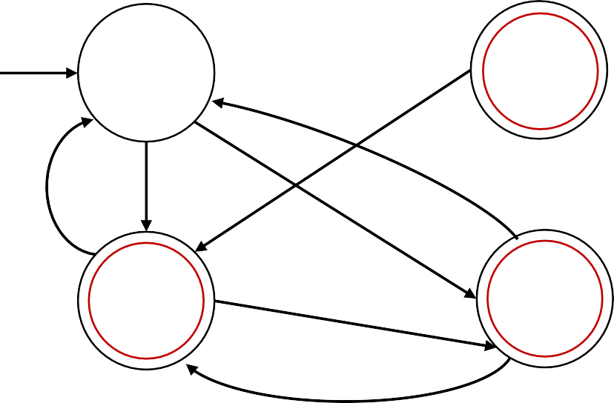
Closure Properties for RegEx - Union
Components of 𝑀:
𝑄𝑄 = 𝑄𝑄₁ × 𝑄𝑄₂
𝑞₀ = (𝑡₀, 𝑟₀)
Example:
𝑀₁
𝑀₂
𝑎
𝑏
𝑎
𝑎, 𝑏
𝑡
0
𝑡
1
𝑟₀
𝑟₁
𝛿𝛿 𝑡, 𝑟 , 𝑎 = 𝛿𝛿₁ 𝑡, 𝑎 , 𝛿𝛿₂
𝐹 = 𝐹₁ × 𝑄𝑄₂ ∪ 𝑄𝑄₁ × 𝐹₂
𝑟, 𝑎
𝑎, 𝑏
𝑏
𝑀
𝑡₀ , 𝑟₀
𝑎, 𝑏
𝑡₁ , 𝑟₀
𝑏
𝑏
𝑏
𝑎
𝑡₀ , 𝑟₁
𝑎
𝑡₁ , 𝑟₁
𝑎

Slide 26
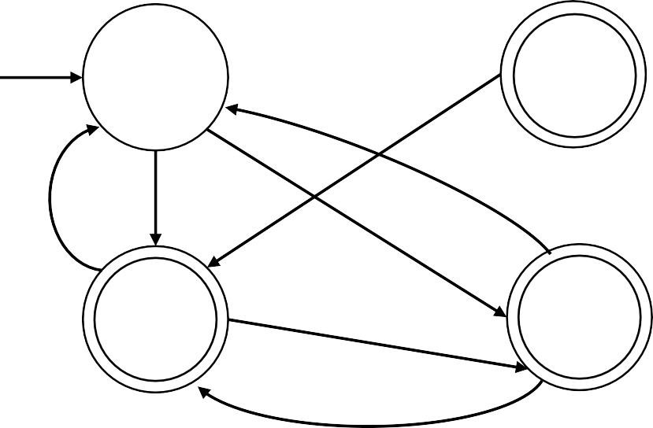
Closure Properties for RegEx - Union
Components of 𝑀:
𝑄𝑄 = 𝑄𝑄₁ × 𝑄𝑄₂
𝑞₀ = (𝑡₀, 𝑟₀)
Example:
𝑀₁
𝑀₂
𝑎
𝑏
𝑎
𝑎, 𝑏
𝑡
0
𝑡
1
𝑟₀
𝑟₁
𝛿𝛿 𝑡, 𝑟 , 𝑎 = 𝛿𝛿₁ 𝑡, 𝑎 , 𝛿𝛿₂
𝐹 = 𝐹₁ × 𝑄𝑄₂ ∪ 𝑄𝑄₁ × 𝐹₂
𝑟, 𝑎
𝑎, 𝑏
𝑏
𝑀
There are no transitions to
𝑡₁, 𝑟₀
𝑡₀ , 𝑟₀
𝑎, 𝑏
𝑡₁ , 𝑟₀
𝑏
𝑏
𝑏
𝑎
𝑡₀ , 𝑟₁
𝑎
𝑡₁ , 𝑟₁
𝑎

Slide 27
Closure Properties for RegEx - Union
Components of 𝑀:
𝑄𝑄 = 𝑄𝑄₁ × 𝑄𝑄₂
𝑞₀ = (𝑡₀, 𝑟₀)
Example:
𝑀₁
𝑀₂
𝑎
𝑏
𝑎
𝑎, 𝑏
𝑡
0
𝑡
1
𝑟₀
𝑟₁
𝛿𝛿 𝑡, 𝑟 , 𝑎 = 𝛿𝛿₁ 𝑡, 𝑎 , 𝛿𝛿₂
𝐹 = 𝐹₁ × 𝑄𝑄₂ ∪ 𝑄𝑄₁ × 𝐹₂
𝑟, 𝑎
𝑎, 𝑏
𝑏
𝑀
𝑡₀ , 𝑟₀
Is the string 𝑤 = 𝑎𝑏𝑎 in 𝑀?
Yes!
𝑏
𝑏
𝑏
Try with: 𝑤₂ = 𝑎𝑏𝑏𝑎𝑎𝑏𝑎
𝑤₃ = 𝑏𝑏𝑏𝑎𝑎𝑏
𝑀 accepts 𝑤₂!
𝑎
𝑡₀ , 𝑟₁
𝑎
𝑡₁ , 𝑟₁
𝑀 does not accept 𝑤₃!
𝑎
∎

Slide 28
Closure Properties for RegEx - Concatenation
Theorem: If 𝐴₁, 𝐴₂ are regular languages, so is 𝐴₁𝐴₂ (closure under ∘) Proof: by Construction
Let 𝑀₁ = (𝑄𝑄₁, Z, 𝛿𝛿₁ , 𝑞₁ , 𝐹₁ ) recognize 𝐴₁
𝑀₂ = (𝑄𝑄₂, Z, 𝛿𝛿₂ , 𝑞₂ , 𝐹₂ ) recognize 𝐴₂
Construct 𝑀 = (𝑄𝑄 , Z, 𝛿𝛿 , 𝑞₀, 𝐹) recognizing 𝐴₁𝐴₂
Tentative
𝑀₁
𝑎
𝑡
1
Glue the accept state of 𝑀₁ to the start state of 𝑀₂
𝑡
0
𝑏
𝑡₂
𝑀
𝑀₁
𝑎
𝑡
𝑀₂
1
𝑎
𝑔₁
𝑀₂
𝑎
𝑔
𝑡₀
𝑔
1
0
𝑔₀
𝑏
𝑡₂
𝑏
𝑔₂
𝑏
𝑔₂

Slide 29
Closure Properties for RegEx - Concatenation
Theorem: If 𝐴₁, 𝐴₂ are regular languages, so is 𝐴₁𝐴₂ (closure under ∘) Proof: by Construction
Let 𝑀₁ = (𝑄𝑄₁, Z, 𝛿𝛿₁ , 𝑞₁ , 𝐹₁ ) recognize 𝐴₁
𝑀₂ = (𝑄𝑄₂, Z, 𝛿𝛿₂ , 𝑞₂ , 𝐹₂ ) recognize 𝐴₂
Construct 𝑀 = (𝑄𝑄 , Z, 𝛿𝛿 , 𝑞₀, 𝐹) recognizing 𝐴₁𝐴₂
Tentative
𝑀₁
𝑎
𝑡
1
Glue the accept state of 𝑀₁ to the start state of 𝑀₂
𝑡
0
𝑏
𝑡₂
𝑀
𝑀₁
𝑎
𝑡
𝑀₂
1
𝑎
𝑔₁
𝑀₂
𝑎
𝑔
𝑡₀
𝑔
1
0
𝑔₀
𝑏
𝑡₂
𝑏
𝑔₂
𝑏
𝑔₂

Slide 30
Closure Properties for RegEx - Concatenation
Theorem: If 𝐴₁, 𝐴₂ are regular languages, so is 𝐴₁𝐴₂ (closure under ∘) Proof: by Construction
Let 𝑀₁ = (𝑄𝑄₁, Z, 𝛿𝛿₁ , 𝑞₁ , 𝐹₁ ) recognize 𝐴₁
𝑀₂ = (𝑄𝑄₂, Z, 𝛿𝛿₂ , 𝑞₂ , 𝐹₂ ) recognize 𝐴₂
Construct 𝑀 = (𝑄𝑄 , Z, 𝛿𝛿 , 𝑞₀, 𝐹) recognizing 𝐴₁𝐴₂
Tentative
𝑀₁
𝑎
𝑀
𝑡₁
𝑀₁
𝑎
𝑀₂
𝑡₀
𝑡
1
𝑎
𝑔₁
𝑏
𝑡₂
𝑡₀
𝑔₀
𝑏
𝑡₂
𝑏
𝑔₂
𝑀₂
𝑎
𝑔
1
𝑀 should accept input 𝑤 if 𝑤 = 𝑥𝑦 where
𝑔₀
𝑀₁ accepts 𝑥 and 𝑀₂ accepts 𝑦.
𝑔₂
𝑤
Doesn’t work: Where to split 𝑤?
𝑏
𝑥 𝑦

Slide 31
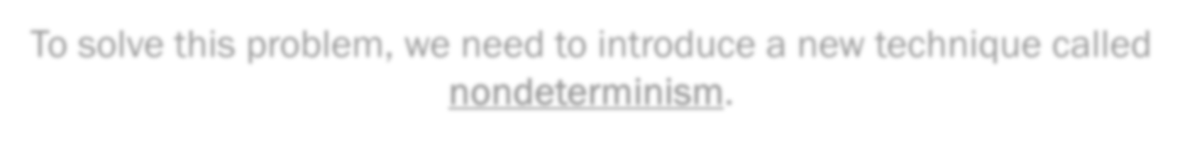
Closure Properties for RegEx - Concatenation
Theorem: If 𝐴₁, 𝐴₂ are regular languages, so is 𝐴₁𝐴₂ (closure under ∘) Proof: by Construction
Let 𝑀₁ = (𝑄𝑄₁, Z, 𝛿𝛿₁ , 𝑞₁ , 𝐹₁ ) recognize 𝐴₁
𝑀₂ = (𝑄𝑄₂, Z, 𝛿𝛿₂ , 𝑞₂ , 𝐹₂ ) recognize 𝐴₂
Construct 𝑀 = (𝑄𝑄 , Z, 𝛿𝛿 , 𝑞₀, 𝐹) recognizing 𝐴₁𝐴₂
Tentative
^{𝑀1} 𝑎 _{𝑡} 𝑀
1 _{𝑀1 𝑀}
𝑎 2
𝑡₀ ^{𝑡}1 ^{𝑎} 𝑔₁
_{𝑏} 𝑡₂ ^{𝑡}0 𝑔₀
𝑏 ^{𝑡}2 _{𝑏} 𝑔₂
𝑀₂
^{𝑎 𝑔1} 𝑀 should accept input 𝑤 if 𝑤 = 𝑥𝑦 where
^{𝑔}0 𝑀₁ accepts 𝑥 and 𝑀₂ accepts 𝑦.
_{𝑏 𝑔2 𝑤} Doesn’t work:
_{𝑥 𝑦} Where to split 𝑤?
To solve this problem, we need to introduce a new technique called nondeterminism.

Slide 32
Wrap-up
Regular operations:
Regular expressions:
Union ∪ Concatenation ∘ Star ∗
Z∗11Z∗ = all the strings that contain 11
Closure properties for regular expressions
  Proved that regular languages are closed under Union
  Started trying to prove closure for concatenations, but something was missing.

Slide 33
Next class
Non-determinism
Prove closure under concatenation and star

